Slide 1
Scaling up by 2035: Opportunities for the UK CAM sector
An aggregation of key Zenzic insights
12 July 2024
zenzic.io

Slide 2
Scaling up by 2035: Opportunities for the UK CAM sector / Zenzic
1.1 / Seven interlinked key areas of opportunity
CAM Identity
Commercial
Business Case
Regulation
Insurance
Public Acceptance
Connectivity
Skills

Slide 3
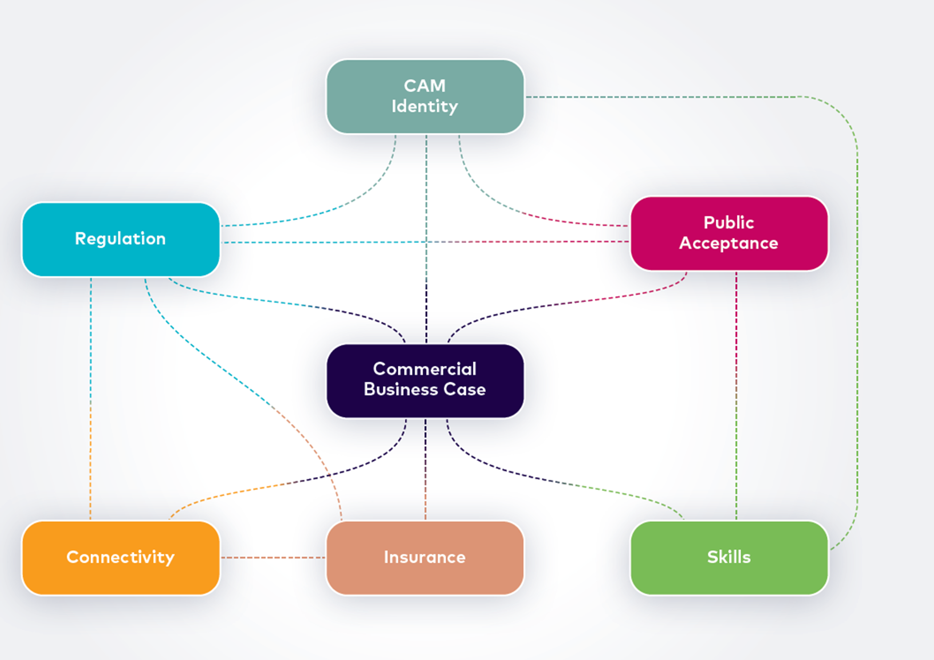
The big picture
Notes:
I hope that looking at the linkages displayed here certain elements resonate strongly with some of you here on the call today.
For example, to me it becomes immediately apparent that the focal point of all this is the creation and evidencing of a viable business case that is the key lever to any commersial activities.
However, to achieve it, all of the remaining "pieces of the puzzle" need to fall in place. Things like the insurance products being readily available, the clear regulatory framework and a common vision for the sector direction, or as we like to call it in-house: the "CAM Identity" that almost sits on top of all other elements.

Slide 4
2 / CAM Identity provides direction
Challenges
Consolidated vision
Maturity level and timings
Market pull
Regional and local “identities”
Opportunities
Strong UK sector messaging at national and international level
Clear priorities on focus areas of development
Identity around cluster of developments e.g. passenger services, in a region
Increased collaboration through early engagement with demand side (“market pull”)
Notes:
Through our work on the International CAM Landscape looking into 7 other key global market players, it became apparent that wether conciously or not each country is displaying a more coherent vision for CAM and its implementation. This CAM Identitiy seems to be formulated on the basis of a combination of factors:
• by technology application focus
• industry supply chain strengths (CAM specific and broader)
• early adoption of CAM market ready elements and/or
• societal direction of products and services implementation.
The UK CAM Roadmap to 20235 identified 4 focus areas where CAM can unlock the most social, economic and environmentsl potential that can be used as the corner-stone to aligning on a shared CAM mission. A vision to rally behind domestically and that can be propagated internationally to increase the UK market visibility.
As the level of sector maturity is still low, the time is opportune to focus in on priority application and implementation areas without disrupting existing supply chains. A strong market pull is needed to vitalise the demand for services and products, those services and products, however, need to be aligned with the actual need of the public. To that end early engagement and collaboration with Opertors and commisioners is vital to both support them in their business case creation to drive up that demand and to ensure a people-oriented industry

Slide 5
/ Recommendations
Scaling up by 2035: Opportunities for the UK CAM sector / Zenzic
Legend:
Government
Industry Academia
Create a clear CAM focus | Recipients for recommendation
Creation of coordinated sector level development strategy, with interventions and industry focus on areas of high opportunity and focused on providing a CAM service
The UK needs to broadcast internationally a CAM identity that promotes and aligns with what progress is happening to attract players.
Collaboration between the tech providers and potential operators to ensure that CAM is on roadmaps for commissioners, operators and OEMs is crucial to formulating the business case for service operation and driving a strong demand for CAM solutions.

Slide 6
Building a successful CAM business case
Opportunities to Scale

Slide 7
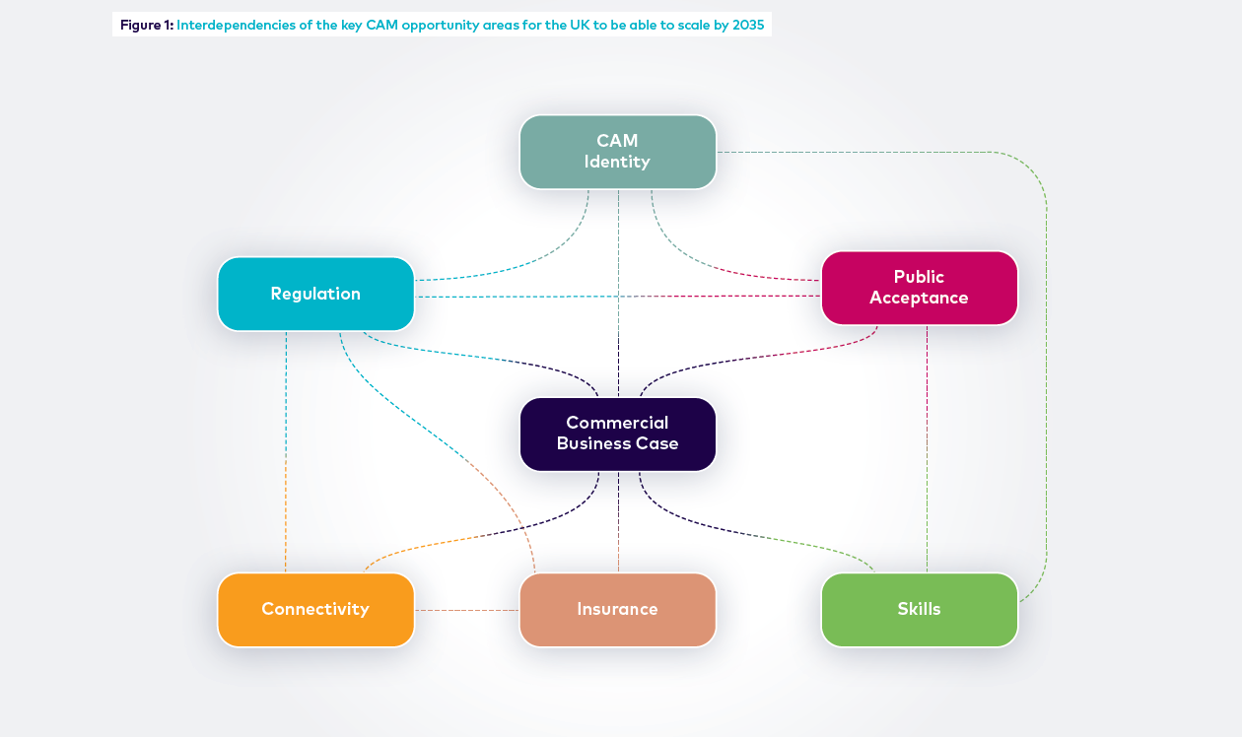

Slide 9
What does this mean in practice
Focus on “high opportunity areas”
Identify early commercial use cases
Create technology stepping stones
Focus…
…on where the problems can be solved today…
Customer need…
…will always trump superior technology…
Agility and flexibility
…in responding to needs will position you best…
What problem does the technology / product / service solve?
Who is willing to pay for that problem to be solved?
How can you start small, demonstrate value, and scale fast?

Slide 10
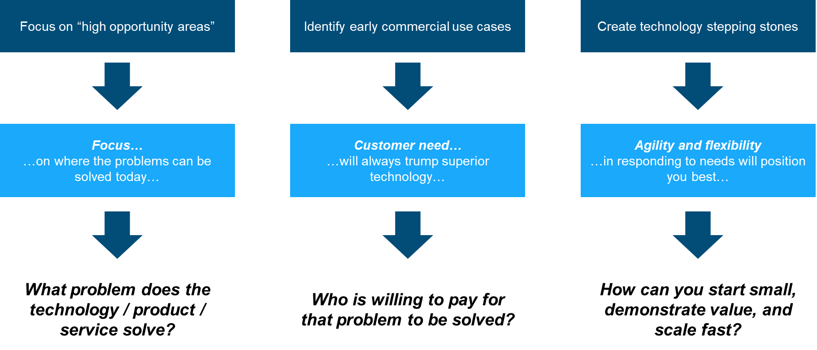
Deciding where to focus
Supporting Technology
Off-highway
On-highway
Positioning
Systems
ADAS
“In the loop”
applications
AI & Machine
Learning
Material
Handling
Equipment
Driverless
Passenger
Vehicles
Autonomous
Taxis
Airports &
Aviation
Agriculture
Electric
Vehicles
5G
LIDAR
RADAR
Sensors
Rail
Military &
Defence
Mining
Buses
Trucks &
Freight
Alternative
Mobility
Robotics
Cloud
UWB
Data logging
Construction
Maritime
& Ports
Logistics
Last Mile
Delivery

Slide 11
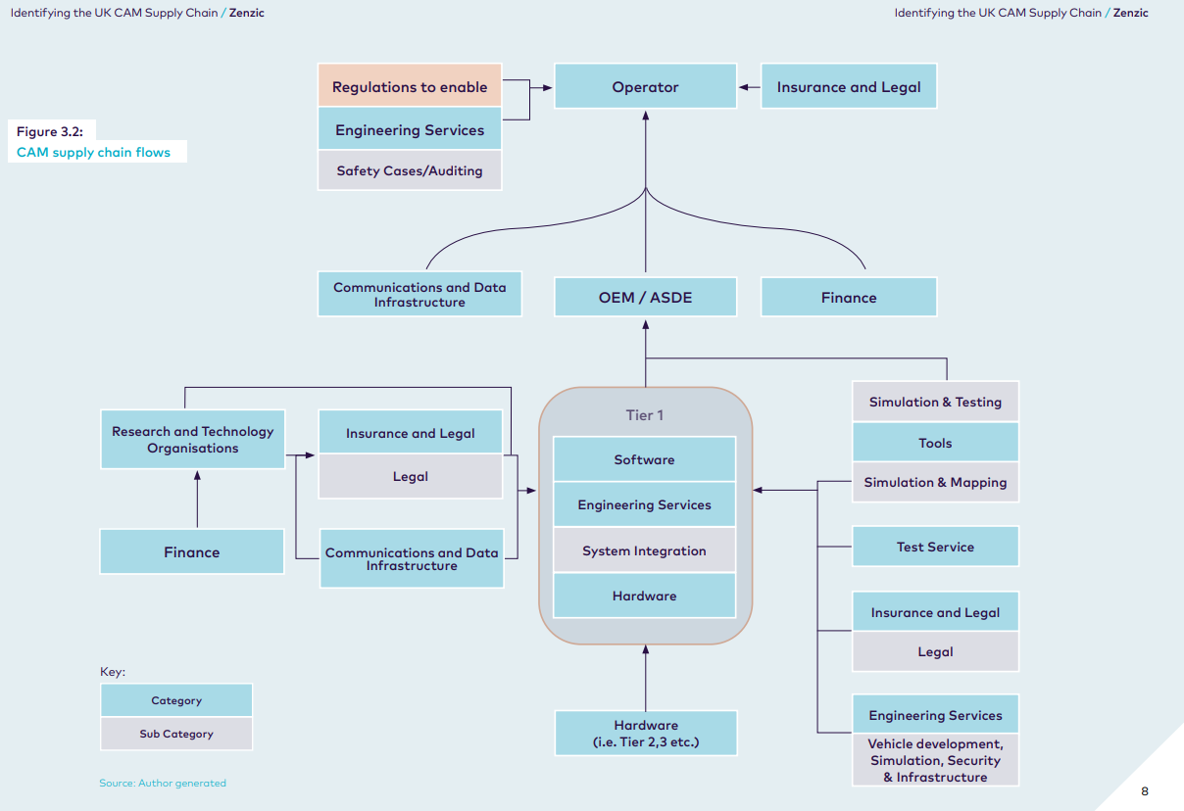
Identifying your customers

Slide 12
Building your business case around your customer value proposition
CUSTOMER VALUE PROPOSITION (CVP)
Market | What is the target market?
Customer | Who are the target customers?
Customer issue | What is really important to your target customers? What are their unmet needs or concerns?
The offer (against needs) | Customer needs: What are the specific needs of the customer? | Offer: What is our corresponding offer to each of those needs?
 | What is the essence of your specific customer offer? How does this address the customer issue?
Benefits | What are the unique benefits that differentiates you from your competitors? | What additional benefits further differentiate you from your competitors?
Reason to believe | What evidence supports your claim?
Go to market | How will we take this to market? What will be our channel and delivery strategy? What price position will we take in the market?
Key communications | What do we focus on in our communication for this offer?
Trade-offs | What will the customer NOT get from us (that might be available from competitors)?

Slide 13
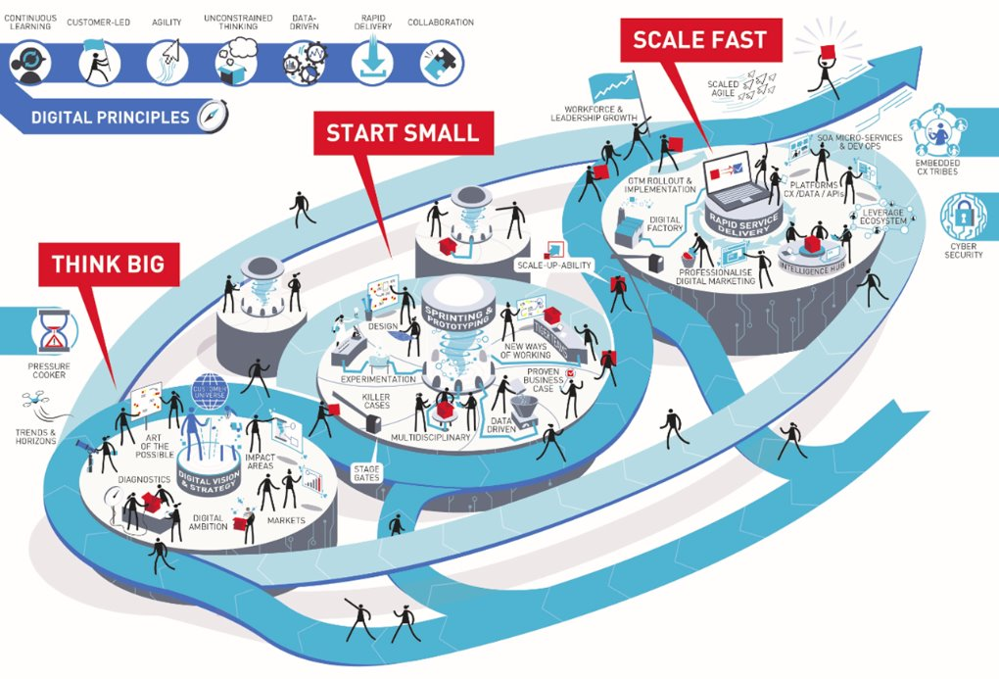
Building a business case to scale effectively
A
Think Big
Be clear on the vision and how you pitch it. How does your product / service / product change the market and meet customer needs today and in the future. What’s the timeframe for your “end state vision”?
Start Small
Demonstrate value early with pilots, trials, demos, etc. Focus on a segment / target market area and deliver benefits that are meaningful as soon as possible.
Scale Fast
Build with the end state in mind. Your technology and platforms should be able to be scaled quickly where possible – don’t be constrained by personnel or become a single point of failure! Pivot with opportunities as they emerge.
B
C

Slide 16
Autonomous Vehicles
Placeholder for optional client logo
Insurance and risk perspectives; “Opportunities for the UK CAM Sector” Zenzic webinar
Friday 12th July 2024
Sam Tiltman, Marsh UK SE+M Group Leader

Slide 17
Opening remarks
Being a part of the solution, not the problem
Insurance, one of the key components in getting AVs operational and enabling trust
Insurance costs can be one of the highest OpEx constituents for New Mobility companies
Significant opportunity to drive down risk, improve societal outcomes and increase efficiencies
The insurance industry can be slow-moving but also has a long track record of supporting innovation
A significant % (typically 30-50%) of GWP is B2B/B2C motor lines – this is likely to be disrupted significantly by New Mobility, especially AV
MMC considers AV to present a major opportunity for the global (re)insurance industry to step up and be a key part of the equation. For us, it’s a question of relevance and value; and (re)insurers need to invest now for the future.

Slide 18
Insurance considerations to support CAM
Not a last-minute thing
Focus areas
Horizontal mobility approach versus vertical product silos – composite portfolio approach
Co-creation flexibility with clients; not “selling” insurance, being a proactive business enablement strategic partner – mindset
Shifting from non-commercial R&D, testing, mapping, proof-of-concept, trials etc. to (pre)commercial operations (public, private, passenger etc.).
Public v Private v Hybrid domains, ODDs, industry adoption (e.g. industrial, passenger transit, public-private ecosystems)
Can only insure something which is legal
Transition – (semi)automation towards full autonomy, a grey world and shifting tides
International considerations
USA v UK v EU v CHINA
Reg → deploy
Deploy → Reg
Litigation environment
Speed of development
Insurance ecosystems
State v Federal
Regional v National

Slide 19
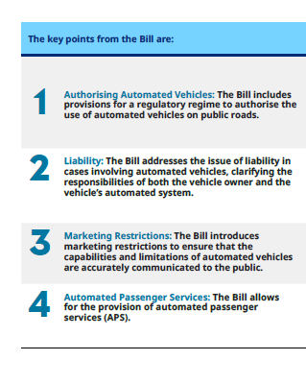
UK AV Bill
Marsh risk and insurance POVs
Insurance not mentioned much in the Bill
Secondary legislation – good time for (re)insurers and stakeholders to shape risk and insurance needs to support commercialisation and mass deployment
Specific risk and insurance considerations
Who will the “operators” be?
Not just about “movement” risks – regulations present additional risks across people, management, IP, “cyber”, financial etc.
Insurance is fundamental to the successful deployment of CAM on a mass basis. The industry deals in risk; how can we expect the public to trust and support AV if the insurance industry doesn’t support it?

Slide 20
Evolving insurance and risk landscape
Key points
Separate insurance products (silos) do not work well for New Mobility → require solutions-based approach on a co-creation basis
Insurance follows laws and regulation, as well as its own contract/insurance legal frameworks; which present major technical challenges for AV deployments
Disruptive innovations pick up significant press interest – events can be amplified significantly and create additional crises
Insurers concerned about “nuclear verdicts” in USA and in general responses to AV incidents and resultant litigation – current legal uncertainty*
Public perception key, as well as building trust in the technologies; and increasingly insurance support being considered as a key enabler here
AVs will present major shifts in the liability landscape – coming to a general industry position on liability attachment/detachment and apportionment will be vital
*and potential collective actions/Group Litigation in the UK as well as proposed class action law in the EU states and more specifically the EU Directive on Representative Actions

Slide 21
Registered in England and Wales Number: 1507274, Registered Office: 1 Tower Place West, Tower Place, London EC3R 5BU. Marsh Ltd is authorised and regulated by the Financial Conduct Authority for General Insurance Distribution and Credit Broking (Firm Reference No. 307511).

